Slide 1
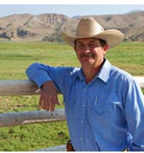
UI & ASA Cooperative Projects
John B. Hall, Ph.D.
Extension Beef Specialist
University of Idaho

Slide 2
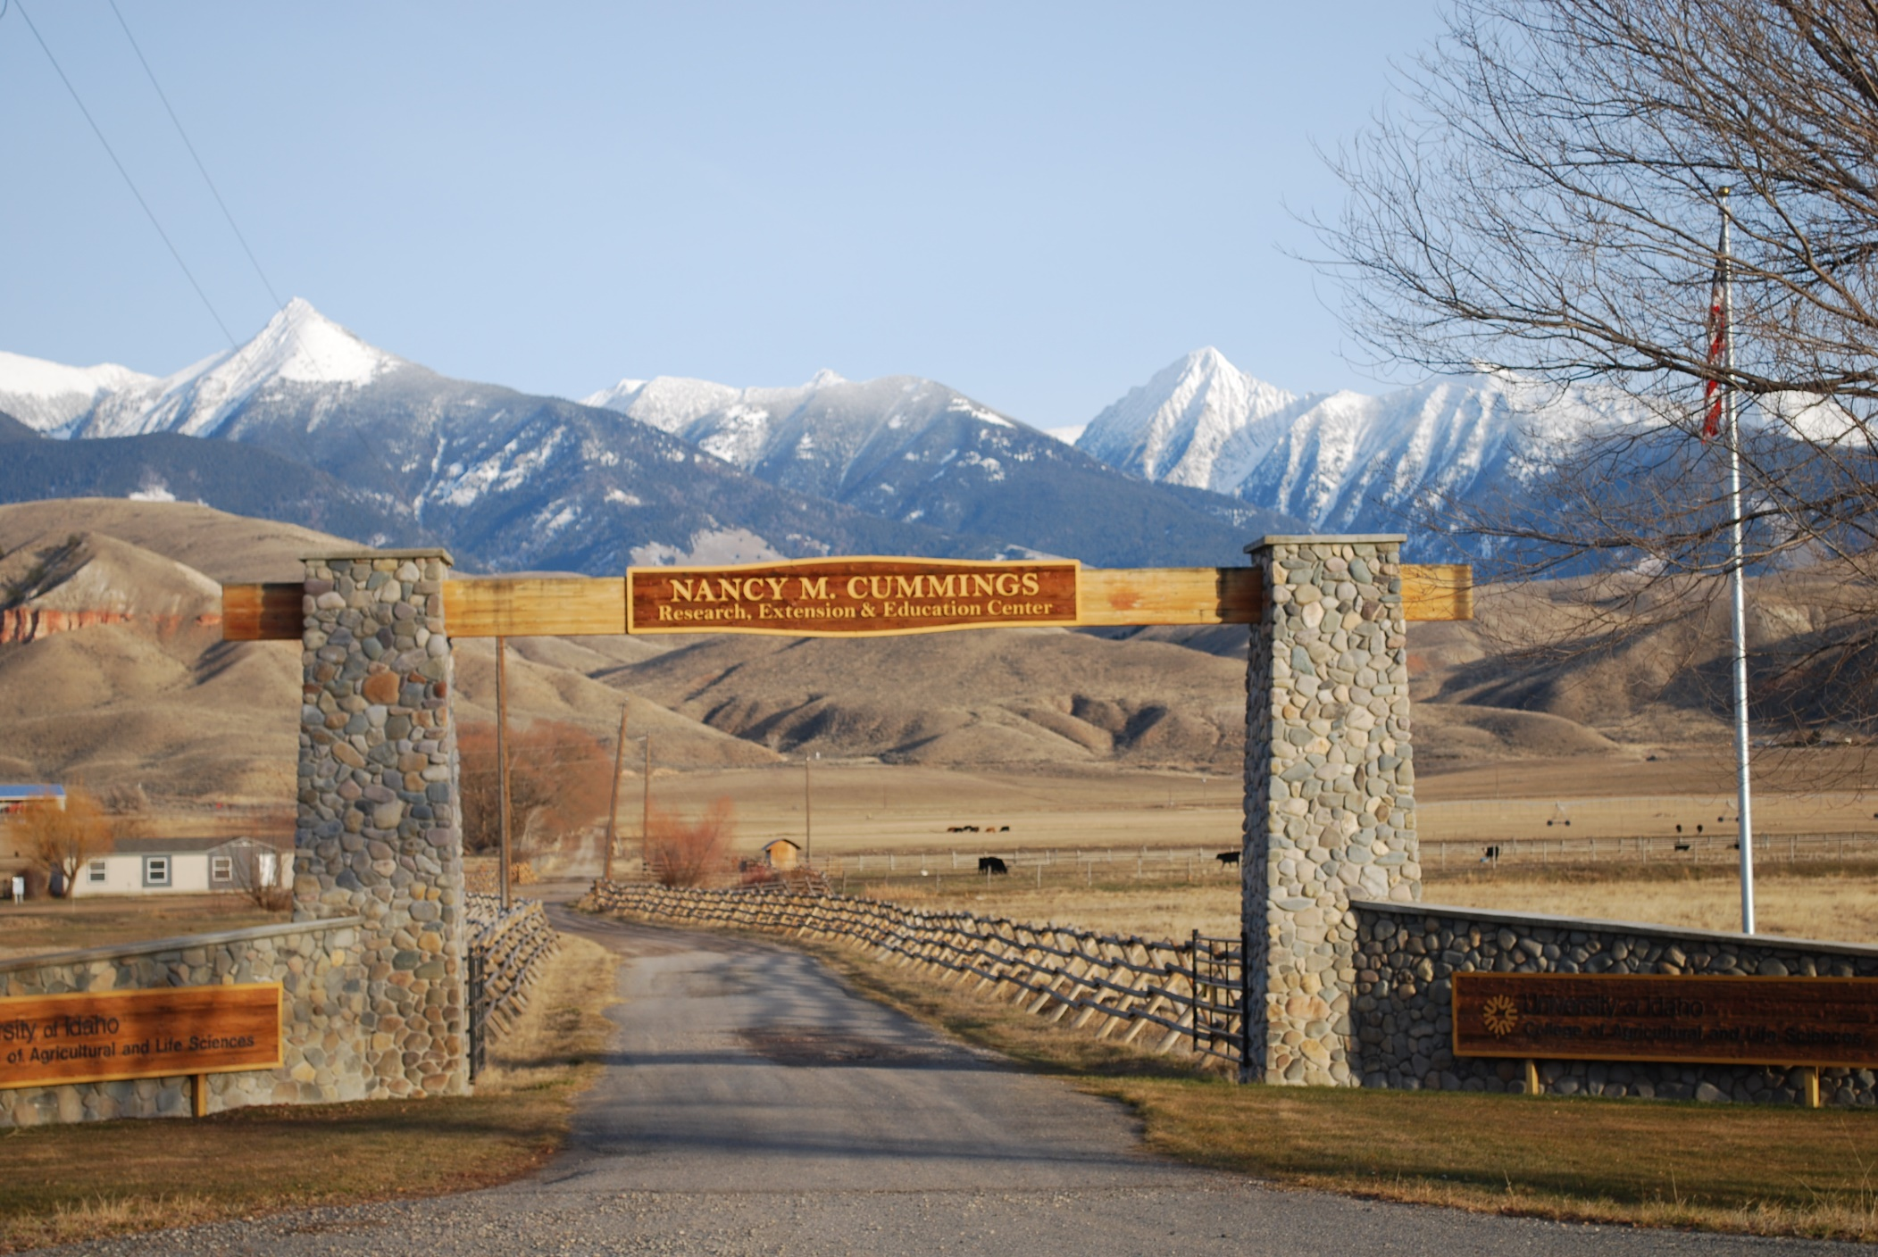
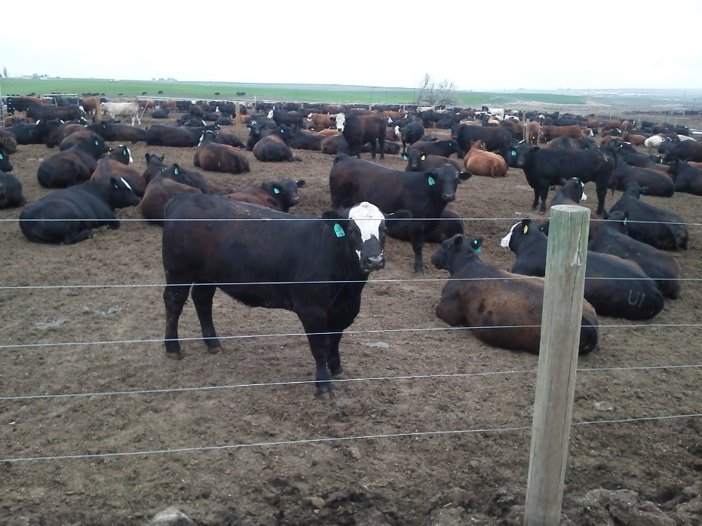

Slide 3
Objectives
Demonstrate value of crossbreeding and crossbred bulls
Add data to ASA database
Young sires
Carcass data
Develop EPD’s for UI Commercial Cow Herd
Add to genomic information on Simmental influenced cattle

Slide 4
Sire | Breed of Sire² | AI or NS Sire³ | Number of Calves | Birth Weight (BWT) | Weaning Weight (WWT) | Age at Weaning | ADG Birth to Weaning | Age Adjusted WWT
A | AN | AI | 12 | 85.4 | 612.7 | 207.0 | 2.54 | 607.6
B | AN | AI | 1 | 90 | 634.0 | 220.0 | 2.47 | 596.9
C | AN | AI | 8 | 77.9 | 588.8 | 221.9 | 2.30 | 549.9
D | AN | AI | 28 | 80.3 | 643.5 | 221.2 | 2.54 | 602.3
E | AN | AI | 9 | 92.2 | 615.3 | 205.1 | 2.55 | 615.0
F | AN | NS | 10 | 75.7 | 547.8 | 204.5 | 2.31 | 548.9
 |  |  | 68 |  |  |  |  | 590.8
G | HH | AI | 7 | 91.4 | 628.0 | 206.6 | 2.60 | 623.8
H | HH | NS | 46 | 90.3 | 558.9 | 172.1 | 2.72 | 648.5
 |  |  | 53 |  |  |  |  | 645.2
I | SM | AI | 16 | 93.8 | 621.1 | 201.6 | 2.62 | 630.0
J | SM | AI | 11 | 87.6 | 614.7 | 202.9 | 2.60 | 620.2
 |  |  | 27 |  |  |  |  | 626.0
K | SM/AN | NS | 26 | 93.2 | 559.1 | 171.6 | 2.72 | 649.9
L | SM/AN | NS | 51 | 99.3 | 580.3 | 177.1 | 2.72 | 656.1
 |  |  | 77 |  |  |  |  | 654.0
M | UK | NS | 3 | 87.7 | 511.3 | 167.3 | 2.53 | 606.7

Slide 5
Sire | Breed of Sire¹ | AI or NS Sire² | Number of Calves | Birth Weight (BWT) | Weaning Weight (WWT) | Age at Weaning | ADG Birth to Weaning | Age Adjusted WWT
Steers
P | AN | AI | 9 | 86.7 | 668.2 | 220.9 | 2.60 | 759.2
AA | AN | AI | 2 | 97.0 | 684.0 | 207.0 | 2.80 | 731.0
R | AN | AI | 12 | 97.7 | 643.8 | 204.3 | 2.70 | 707.2
T | AN | AI | 11 | 88.5 | 644.7 | 205.8 | 2.70 | 697.9
N | AN | AI | 5 | 79.0 | 586.0 | 219.2 | 2.30 | 681.2
O | AN | AI | 3 | 83.3 | 601.3 | 203.0 | 2.60 | 668.3
U | AN | AI | 4 | 78.8 | 567.0 | 207.3 | 2.40 | 610.0
A | AN | AI | 2 | 85.5 | 589.0 | 207.0 | 2.40 | 631.0
BB | AN | AI | 1 | 85.0 | 678.0 | 206.0 | 2.90 | 727.0
 |  |  | 49 |  |  |  |  | 700.0
X | AN | NS | 22 | 90.3 | 526.1 | 154.0 | 2.80 | 731.2
F | AN | NS | 21 | 95.6 | 584.4 | 186.6 | 2.60 | 708.4
 |  |  | 43 |  |  |  |  | 720.1
V | SM | AI | 3 | 110.0 | 703.3 | 204.3 | 2.70 | 759.7
CC | SM | AI | 12 | 101.0 | 645.3 | 203.3 | 2.80 | 707.7
 |  |  | 15 |  |  |  |  | 718.1
DD | SM | NS | 3 | 87.0 | 564.7 | 178.7 | 2.70 | 699.3
I | SM/AN | AI | 12 | 95.4 | 630.5 | 203.7 | 2.60 | 684.6
K | SM/AN | NS | 16 | 99.8 | 580.0 | 167.8 | 2.90 | 767.4
Y | SM/AN | NS | 10 | 94.6 | 554.6 | 169.0 | 2.70 | 704.8
 |  |  | 26 |  |  |  |  | 743.3
M | UK | NS | 47 | 91.6 | 585.9 | 180.4 | 2.70 | 674.6

Slide 6
Where are we headed?
Young sires
More carcass data
Genomic information
Feed efficiency testing
EPD and Indexes for UI herd
?
It’s Up to You!

Slide 7
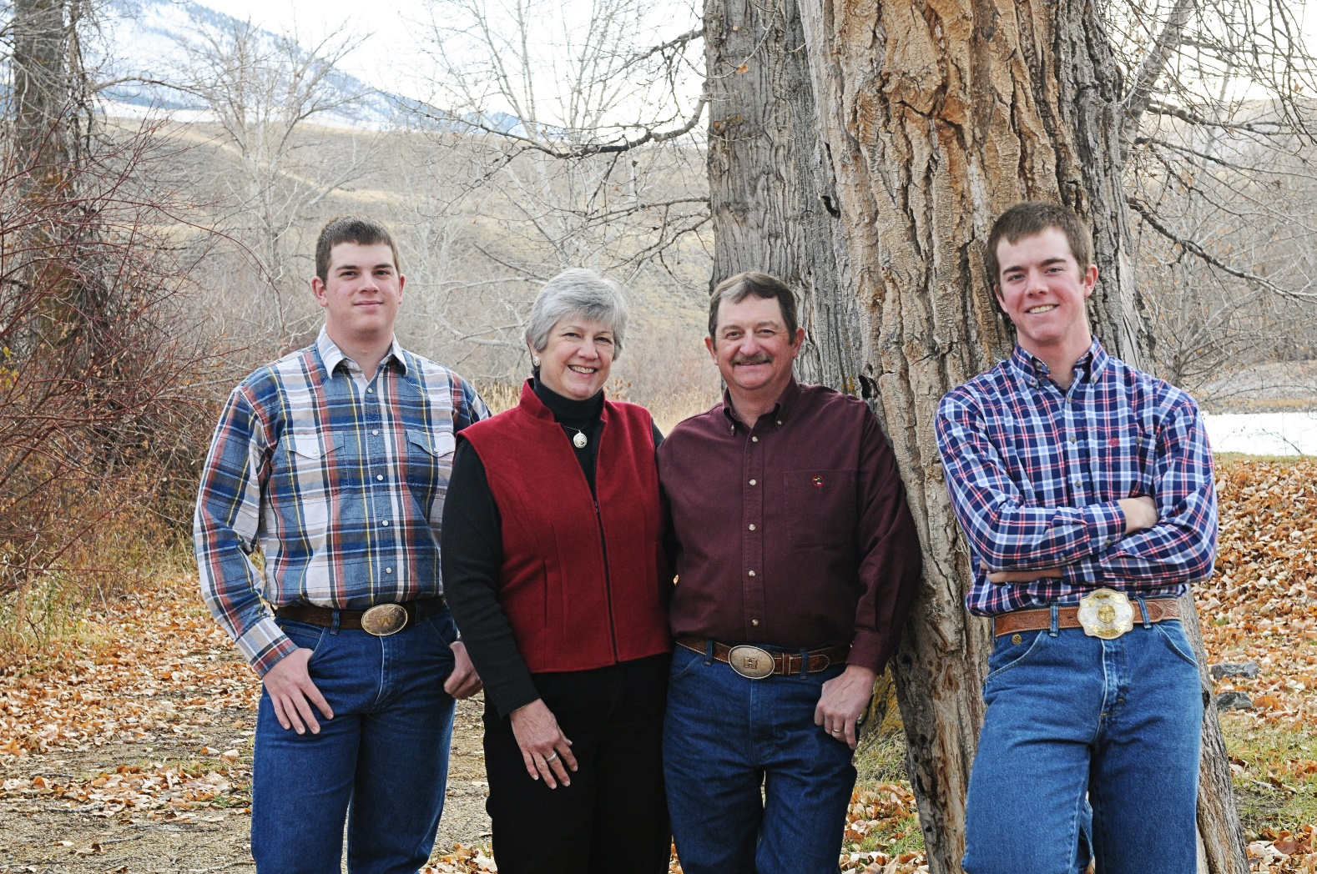

Slide 8
















Nancy M. Cummings Research Extension and Education Center
Industry Partners
Idaho Cattle Association
Bar C K Ranch
Knight Ranch
Lanting Enterprises

