Slide 1


BOLT
A flexible and powerful approach to genetic evaluation
Bruce Golden, PhD.
Department Head and Professor Dairy Science Department Cal Poly

Slide 2

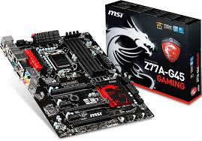
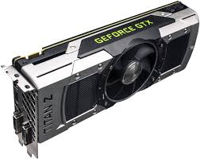
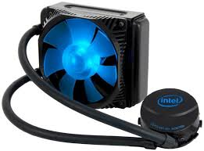
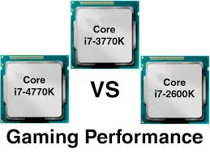

Leveraging technology built for computer gaming

Slide 3
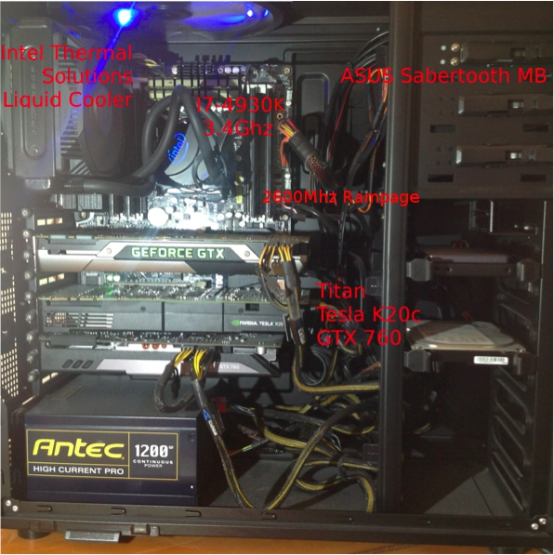

Slide 4


Slide 5

BOLT Major Features
Fine grid to “embarrassingly” parallel capability
  Multi-GPU
  Multi core
  Multi-threaded asynchronous execution
Optimized multi-GPU capability in CUDA
Shared memory
Text files when appropriate
Integrated with Unix User Utilities
Simple user API

Slide 6
Biometry Open Language Toolkit
corr fblockinv mmultongpu mtmgpu
csolve fsolve insbmtx mnvar
absorbx csolves fsolves invert mprint
absorbxm csub genomult invnrm pcgmgpu
astarsetup csubm gpustat pedrecode sthmgibbs
cadd cudacheck grpcnt lambayes permsub
cgen_z cudarnd grpmn libbolt rank
chcat cvcat grps libboltcuda sdate
cholesky cvcatcsr grps2 load2csc shmgr
cln diag ident minmax sp2mm
cmult impute stack_ped ssgibbs
cnewr fbcsrmv imputegpu mmult transM
cnewr2 fblockinv include mmultgpu tsolve

Slide 7
Genetic Evaluation is a 2 step process
ASSEMBLE THE PROBELM
SOLVE THE PROBLEM

Slide 8
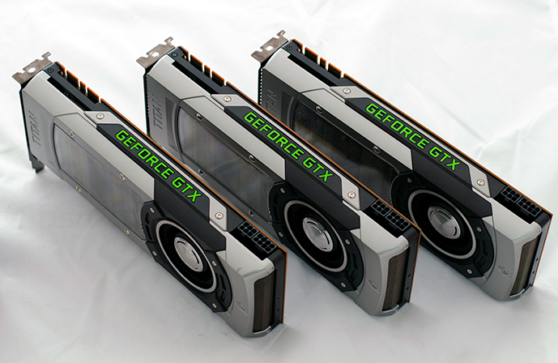
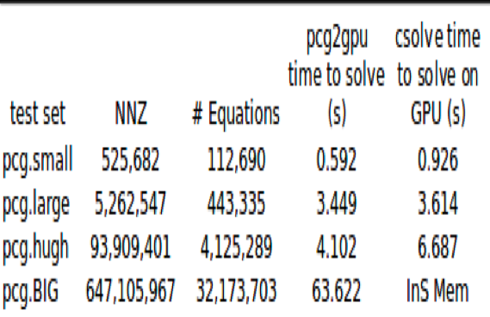
Example Solves
* 1st GPU is Titan, 2nd GPU is Tesla k20c, HOST is I7-4930k 3.4 GhZ (overclocked to 4.13) 6C with HT

Slide 9

Genomic Information
Markers →
M = s11 s12 … s1m
s21 s22 …
. .
. .
. .
sn1 … snm
Animals →

Slide 10
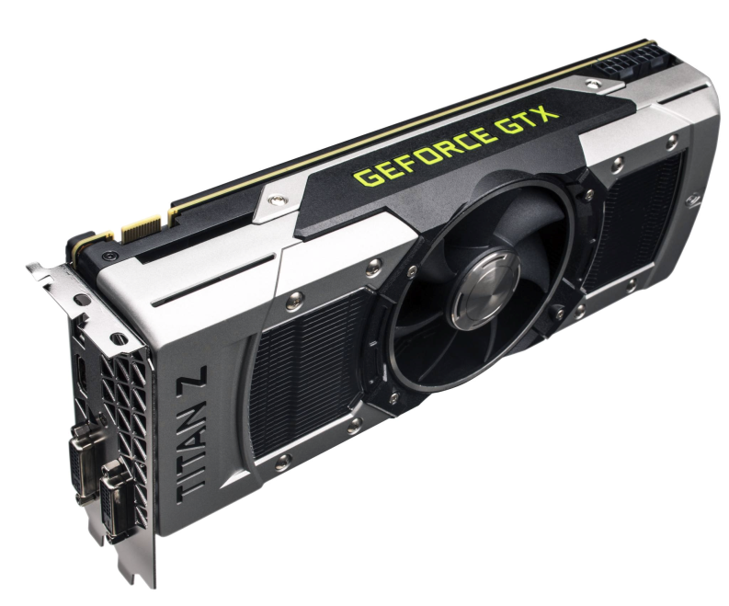
Step when assembling problem is multiply M by itself
M’M
6,625,000,000,000,000
(6.6 quadrillion) computations

Slide 11
Thank you

