Slide 1

Understanding Conventional and Genomic EPDs
Dorian Garrick
dorian@iastate.edu
Notes:
45 minutes

Slide 5
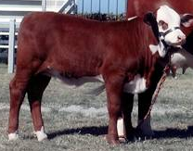
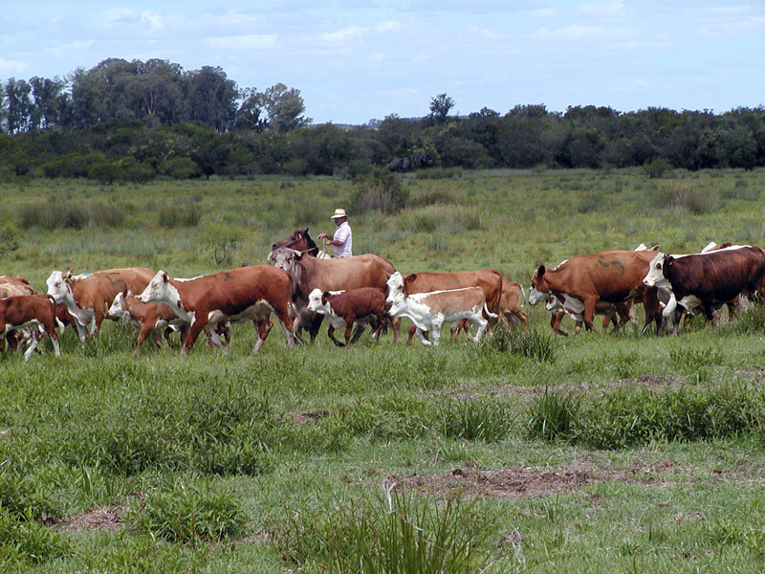
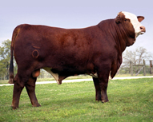
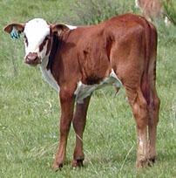
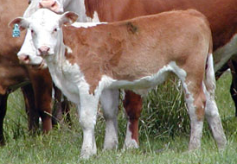
Suppose we generate 100 progeny on 1 bull
Sire
Progeny

Slide 6
Performance of the Progeny
+30 lb
+15 lb
-10 lb
+ 5 lb
Sire
+10 lb
Offspring of one sire exhibit
more than ¾ diversity of
the entire population
Progeny
+10 lb

Slide 7
We learn about parents from progeny
+30 lb
+15 lb
-10 lb
+ 5 lb
Sire
+10 lb
(EPD is “shrunk”)
Sire EPD +8-9 lb
Progeny
+10 lb

Slide 8
Suppose we generate new progeny
Expect them
to be 8-9 lb
heavier than
those from an
average sire
Some will be more
others will be less
but we cant tell
which are better
without “buying”
more information
Sire
Sire EPD +8-9 lb
Progeny

Slide 9
Chromosomes are a sequence of base pairs
Part of 1 pair
of chromosomes
Cattle usually have 30 pairs of chromosomes
One member of each pair was inherited from the sire, one from the dam
Each chromosome has about 100 million base pairs (A, G, T or C)
About 3 billion describe the animal
Blue base pairs represent genes
Yellow represents the strand inherited from the sire
Orange represents the strand inherited from the dam

Slide 10
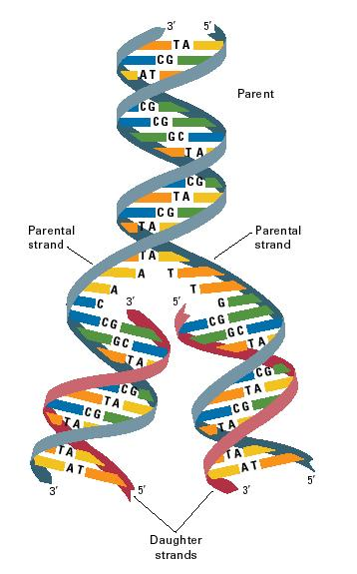
A common error is the
substitution of one base pair
for another
Single Nucleotide Polymorphism
(SNP)
Errors in duplication
Most are repaired
Some will be transmitted
Some of those may influence performance
Some will be beneficial, others harmful
Inspection of whole genome sequence
Demonstrate historical errors
And occasional new (de novo) mutations

Slide 11
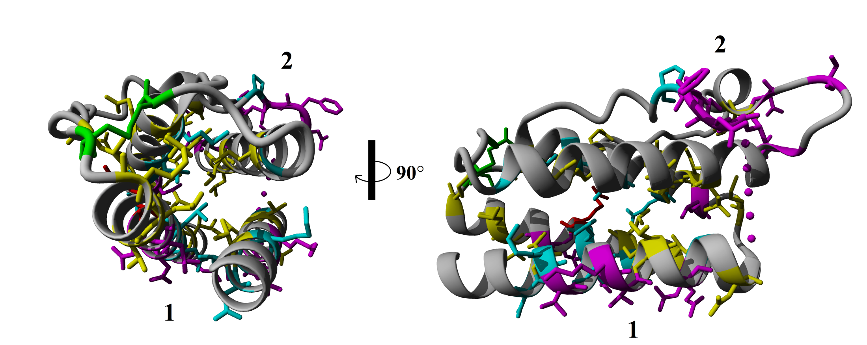
Leptin
Prokop et al, Peptides, 2012

Slide 12
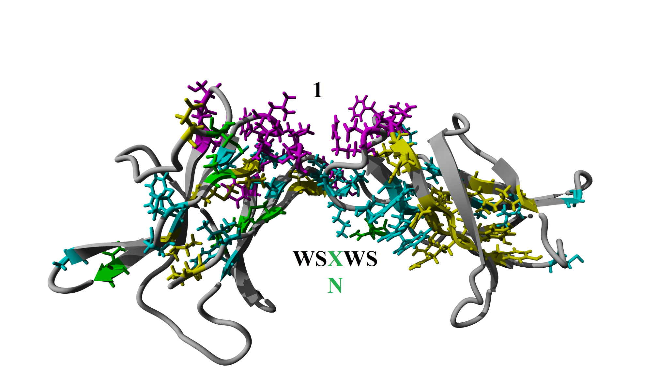
Leptin Receptor
Prokop et al, Peptides, 2012

Slide 13
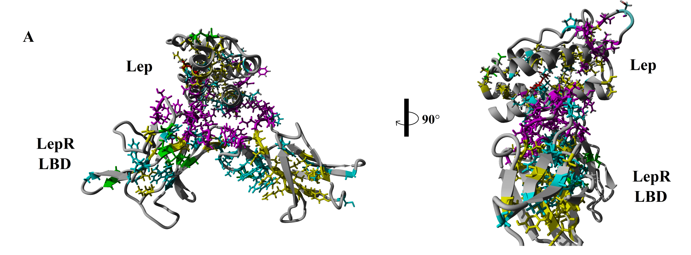
Joining the two
Prokop et al, Peptides, 2012

Slide 14
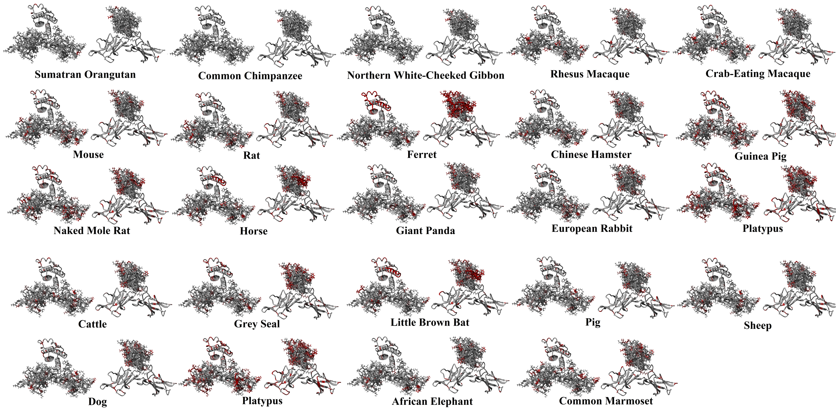
Leptin and its Receptor Across Species
Prokop et al, Peptides, 2012

Slide 15
EPD is half sum of average gene effects
-2
+3
-4
+5
Sum=+2
Sum=+8
EPD=5
+2
-3
+4
+5
Blue base pairs represent genes

Slide 16
Consider 3 Bulls
-2
+3
-4
+5
EPD= 5
+2
-3
+4
+5
-2
+3
+4
-5
EPD= -3
-2
-3
+4
-5
+2
+3
-4
+5
EPD= 1
+2
+3
-4
-5
Below-average bulls will have some above-average alleles and vice versa!

Slide 17
Genome Structure – SNPs everywhere!
Horizontal bars are marker locations
Affymetrix 9,713 SNP
Illumina 50k SNP chip is denser and more even
Marker Position (cM)
Bovine Chromosome
Arias et al., BMC Genet. (2009)

Slide 18
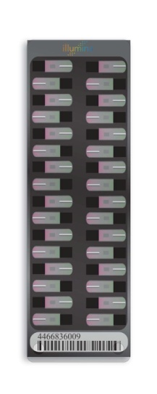

Illumina Bovine 770k, 50k (v2), 3k
700k (HD) $185 50k $80 (Several versions) 3k (LD) $45

Slide 19
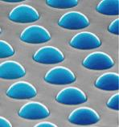

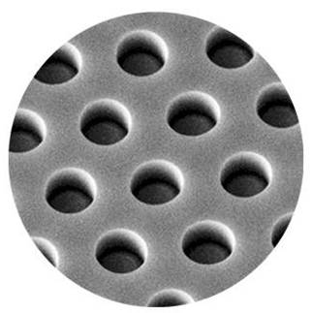
Illumina SNP Bead Chip
BeadChip eg 1,000,000 wells/stripe
Silica glass beads self-assemble into microwells on slides
2um
2um
~800,000 copies of specific oligo per bead 50k or more bead types
Notes:
The heart of Illumina’s technology is based on the fundamental concept of beads in wells, and, more specifically, the random self-assembly of those beads into wells.
Shown here is a SEM of the end of a fiber strand after population with the assay beads
Showing that the etched pits are now completely occupied by the highly regular silica beads.
These beads acts as the functional elements of the array and are evenly covered with about 700 to 800 thousand copies of a specific oligonucleotide that acts as the capture sequence in a genotyping or gene expression assay.
Oblique view has been artificially colored.
Also artist rendered view to help explain that each bead is completely covered In approximately 800 thousand copies of one specific type of illumiCode oligo
The different illumiCode oligos that determine the bead types
The beads are not directly fluorescently labeled; the bead-bound oligos hybridize to fluorescently tagged reaction products from bioassays.
There are several advantages to producing arrays in this way:
One advantage of this approach to array production is that it allows us to manufacture and functionally validate every single array element (bead) independent of the array substrate (fiber bundles or chip) to yield a much higher quality array. In effect we can produce a perfect product from an imperfect process and only ship arrays that pass all of our manufacturing QC steps.
A second advantage is that these arrays have a data density approximately 15X greater than any other commercial array.
It is also easy to see how this type of array is much more flexible as new array types can be generated or existing arrays expanded simply through the production of new bead pools.

Slide 20
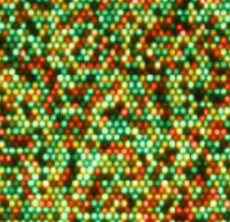
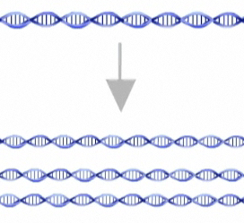
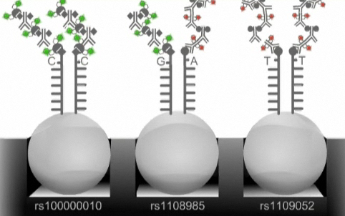
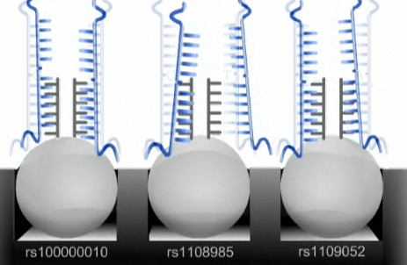
Illumina Infinium SNP genotyping
DNA (eg hair)
sample
Genotypes
reported
Amplification
BeadChip scanned
For red or green
DNA finds its complement on a bead (hybridization)
SNP is labeled with fluorescent dye while on BeadChip

Slide 21
SNP Genotyping the Bulls
1 of 50,000 loci=50k
-2
+3
-4
+5
“AB”
EBV=10
EPD= 5
+2
-3
+4
+5
-2
+3
+4
-5
“BB”
EBV= -6
EPD= -3
-2
-3
+4
-5
+2
+3
-4
+5
“AA”
EBV= 2
EPD=1
+2
+3
-4
-5

Slide 22
Alleles are inherited in blocks
paternal
Chromosome
pair
maternal

Slide 23
Alleles are inherited in blocks
paternal
Chromosome
pair
maternal
Occasionally (30%) one or other chromosome is passed on intact
e.g

Slide 24
Alleles are inherited in blocks
paternal
Chromosome
pair
maternal
Typically (40%) one crossover produces a new recombinant gamete
Recombination
can occur
anywhere
but there are
“hot” spots and
“cold” spots

Slide 25
Alleles are inherited in blocks
paternal
Chromosome
pair
maternal
Sometimes there may be two (20%) or more (10%) crossovers
Never close
together

Slide 26
Alleles are inherited in blocks
paternal
Chromosome
pair
maternal
Interestingly the number of crossovers varies between sires and is heritable
On
average
1 crossover
per
chromosome
per
generation
Possible
offspring
chromosome
inherited from
one parent

Slide 27
Alleles are inherited in blocks
paternal
Chromosome
pair
maternal
Consider a small window of say 1% chromosome (1 Mb)

Slide 28
Alleles are inherited in blocks
paternal
Chromosome
pair
maternal
Offspring mostly (99%) segregate blue or red (about 1% are admixed)
“Blue”
haplotype
(eg sires
paternal
chromosome)
“Red”
haplotype
(eg sires
maternal
chromosome)

Slide 29
Alleles are inherited in blocks
paternal
Chromosome
pair
maternal
Offspring mostly (99%) segregate blue or red (about 1% are admixed)
-4
“Blue”
haplotype
(eg sires
paternal
chromosome)
-4
-4
-4
“Red”
haplotype
(eg sires
maternal
chromosome)
+4
+4
+4

Slide 30
Regress BV on haplotype dosage
Breeding Value
Use multiple regression
to simultaneously estimate dosage of
all haplotypes (colors)
in every 1 Mb window
0
1
2 “blue” alleles

Slide 31
Consider original Bulls
-2
+3
-4
+5
EPD= 5
+2
-3
+4
+5
-4
+4
Below-average bulls will have some above-average alleles and vice versa!

Slide 32
Consider Original Bull
-2
+3
-4
+5
EPD= 5
+2
-3
+4
+5
-2
+3
-4
+5
EPD= 5
+2
-3
+4
+5
Use EPD of genome fragments to determine the EPD of the bull
Estimate the EPD of genome fragments using historical data

Slide 33
K-fold Cross Validation
Partition the dataset into k (say 3) groups
 | G1
 | G2 | ✓
 | G3 | ✓
Validation |  | G1
Training
Derive MBV
Compute the
correlation between
predicted genetic
merit from MBV and
observed performance

Slide 34
SIM
SIM
AAN
GVH
RAN
RDP

Slide 35
80-87%
<60%
100%
(BLACK)
>95%
60-80%
AAN
GVH
87-95%
RDP
RAN

Slide 36
3-fold Cross Validation
Every animal is in exactly one validation set
 | G1 |  | ✓ | ✓
 | G2 | ✓ |  | ✓
 | G3 | ✓ | ✓
Validation |  | G1 | G2 | G3
Training
Genetic relationship between training and validation data influences results!

Slide 37
Predictions in US Breeds
Trait | RedAngus (6,412) | Angus (3,500) | Hereford (2,980) | Simmental (2,800) | Limousin (2,400) | Gelbvieh (1,321)+
BirthWt | 0.75 | 0.64 | 0.68 | 0.65 | 0.58 | 0.62
WeanWt | 0.67 | 0.67 | 0.52 | 0.52 | 0.58 | 0.52
YlgWt | 0.69 | 0.75 | 0.60 | 0.45 | 0.76 | 0.53
Milk | 0.51 | 0.51 | 0.37 | 0.34 | 0.46 | 0.39
Fat | 0.90 | 0.70 | 0.48 | 0.29 |  | 0.75
REA | 0.75 | 0.75 | 0.49 | 0.59 | 0.63 | 0.61
Marbling | 0.85 | 0.80 | 0.43 | 0.63 | 0.65 | 0.87
CED | 0.60 | 0.69 | 0.68 | 0.45 | 0.52 | 0.47
CEM | 0.32 | 0.73 | 0.51 | 0.32 | 0.51 | 0.62
SC |  | 0.71 | 0.43 |  | 0.45
Average | 0.67 | 0.69 | 0.52 | 0.47 | 0.57 | 0.56
Genetic correlations from k-fold validation
Saatchi et al (GSE, 2011; 2012; J Anim Sc, 2013)

Slide 38
Genomic Prediction Pipeline
Iowa State
NBCEC
Breeders
Prediction Equation
Hair/DNA
GeneSeek
GeneSeek running the
Beagle pipeline GGP to 50k then
applying prediction equation
Reports
MBV and genotypes
ASA
Blend MBV & EPD

Slide 39
Impact on Accuracy--%GV=50%
Genetic correlation=0.7
Pedigree and
genomic
Pedigree only
Genomics will not improve the accuracy of a bull that already has an accurate EPD

Slide 40
Impact on Accuracy--%GV=64%
Genetic correlation=0.8
Pedigree and
genomic
Return on
genotyping
investment
Pedigree only
Genomic EPDs are equally likely to be better or worse than without genomics

Slide 41
Major Regions for Birth Weight
Genetic Variance %
Chr_mb | Angus | Hereford | Shorthorn | Limousin | Simmental | Gelbvieh
7_93 | 7.10 | 5.85 | 0.01 | 0.02 | 0.18 | 0.02
6_38-39 | 0.47 | 8.48 | 11.63 | 5.90 | 16.3 | 4.75
20_4 | 3.70 | 7.99 | 1.19 | 0.07 | 1.53 | 0.03
14_24-26 | 0.42 | 0.01 | 0.01 | 0.71 | 3.05 | 8.14
Adding Haplotypes
3.20%
5.90%
Imputed 700k
Collective 3 QTL
30% GV
Some of these same regions have big effects on one or more of
weaning weight, yearling weight, marbling, ribeye area, calving ease

Slide 42
PLAG1 on Chromosome 14 @25 Mb
Effect of 1 copy | Growth
Birthweight | 5lb (ASA/CSA data 7lb QQ vs qq)
Weaning weight | 10lb
Feedlot on weight | 16lb
Feedlot off weight | 24lb
Carcass weight | 14lb
Effect of 1 copy | Reproduction
Age CL | 38 days
PPAI | 15 days
Presence CL before weaning | -5%
Weight at CL | 36 lb
Age at 26 cm SC | 19 days

Slide 43
Summary
Genomic prediction, like pedigree-based prediction, is based on concepts that were established decades ago
Genomic prediction is an immature technology, but it maturing rapidly
Existing evaluation systems need considerable research and development to implement genomic prediction

Slide 44
The Future of Genomic Prediction: A Quantum Leap
Notes:
45 minutes

Slide 45
Including Genomics
The calculations to obtain EPDs are quire different when genomic information is included along with pedigree information for non genotyped relatives

Slide 46
Single-trait Equations
Pedigree-based Evaluation

Slide 47
Actual Calculation
Pedigree-based Evaluation

Slide 48
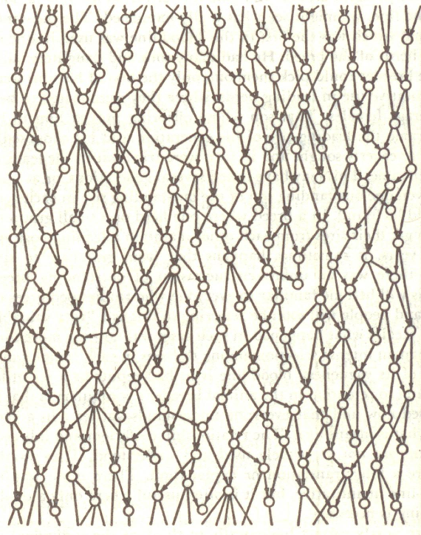
Iterative Solution
Past
Sire
Dam
Individual
Present
Offspring
Future
Pedigree-based Evaluation

Slide 49
Three Sources of Information
Predicting Individual Merit
Parents
From conception
Parents & Individual
From measurement age
Parents, Individ & Offspring OR Parents & Offspring
From mating age, plus gestation and measurement age
Sire
Dam
Increasing Age
Increasing Accuracy
Individual
Offspring

Slide 50
Adding Genomics
Pedigree-based Evaluation Only 3 sources of information on each animal

Slide 51
Adding Genomics
Genotyped and non-genotyped animals Numerous information sources per animal
Kick-starts EPD accuracy for young animals

Slide 52
EPD Accuracy
Various terms to reflect accuracy of EPDs
BIF accuracy (1-sqrt(1-R)) – Beef in America
Accuracy (R) – used in many species (beef Aust)
Reliability (R²) – used in Dairy Evaluations
All are closely related – some hard to interpret

Slide 53
EPD Accuracy
Reliability
proportion of variation in true EPD that can be explained from information used in evaluation
Unreliability = 100-Reliability
proportion of variation in true EPD that cannot be explained from information used in evaluation
Reflects the Prediction Error Variance (PEV)

Slide 54
Two Ways to obtain PEV
Prediction Error Variance can be obtained from
The inverse of the coefficient matrix from the mixed model equations
20 years ago couldn’t be calculated >10,000 EPDs
Cannot be calculated for >100,000 EPDs
Has always been approximated in national evaluations
These approximations don’t work as well with genomics

Slide 55
MCMC Sampling
Markov chain Monte-Carlo (MCMC) sampling
Uses the mixed model equations – but not just to get the single solution – it obtains all the plausible solutions for all the animals given all available information – exact PEV
Most people believe it is too much computer effort to use this method with national evaluation
“Most people” haven’t tried hard enough

Slide 56
MCMC Sampling
Allows BIF accuracy to be computed for
Differences between 2 bulls
Two accurate bulls may not be accurately compared
Groups of bulls
What is the accuracy of teams of bulls?
Differences between groups of bulls
How do my bulls compare to breed average?
How do my bulls compare to 10 years ago?

Slide 57
Quantum Leap Software Tools
Allows inclusion of genomic information from the ground up, rather than as an “add-on”
Allows the use of new computing techniques including parallel computing & graphics cards
Allows calculation of actual accuracies, for any interesting comparisons
Allows routine (eg monthly, weekly) updates
Allows easy updating with new methods

Slide 59
Parallel Computing

Slide 60
Worn out software

