Slide 1
First must come the blinding realization that no one breed excels in all areas that lead to profitability

Slide 2




Crossbreeding Talks in 2014:
Why They're Still Needed
Matt Spangler, Ph.D.
State Ext. Specialist-Beef Genetics
University of Nebraska
402.472.6489
mspangler2@unl.edu
Bob Weaber, Ph.D.
Cow-calf Ext. Specialist
Kansas State University
785-532-1460
bweaber@k-state.edu

Slide 3
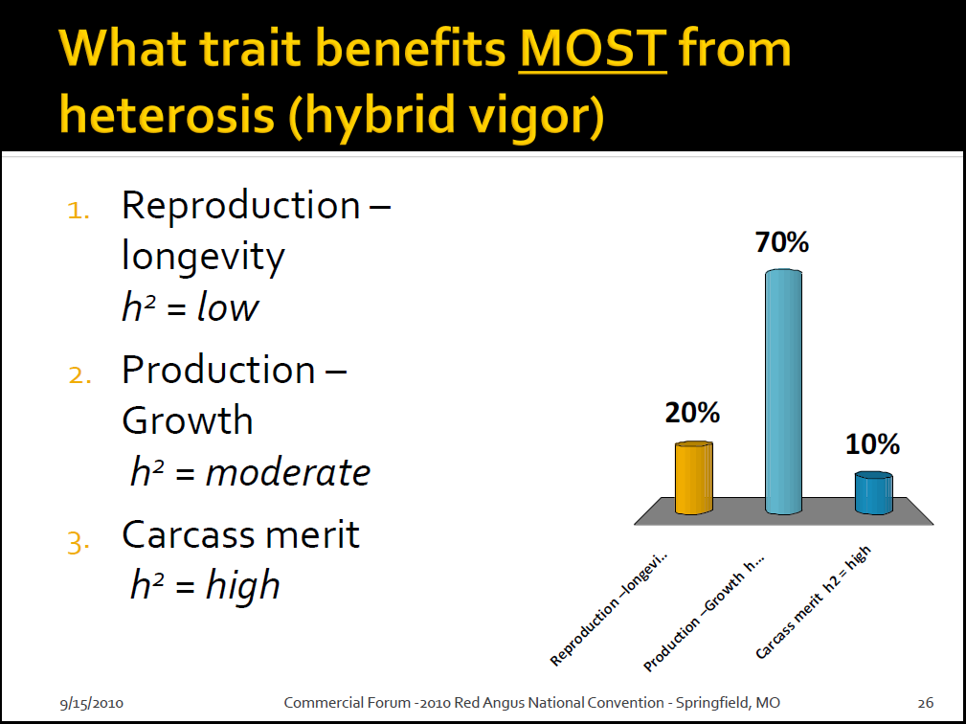

Slide 4
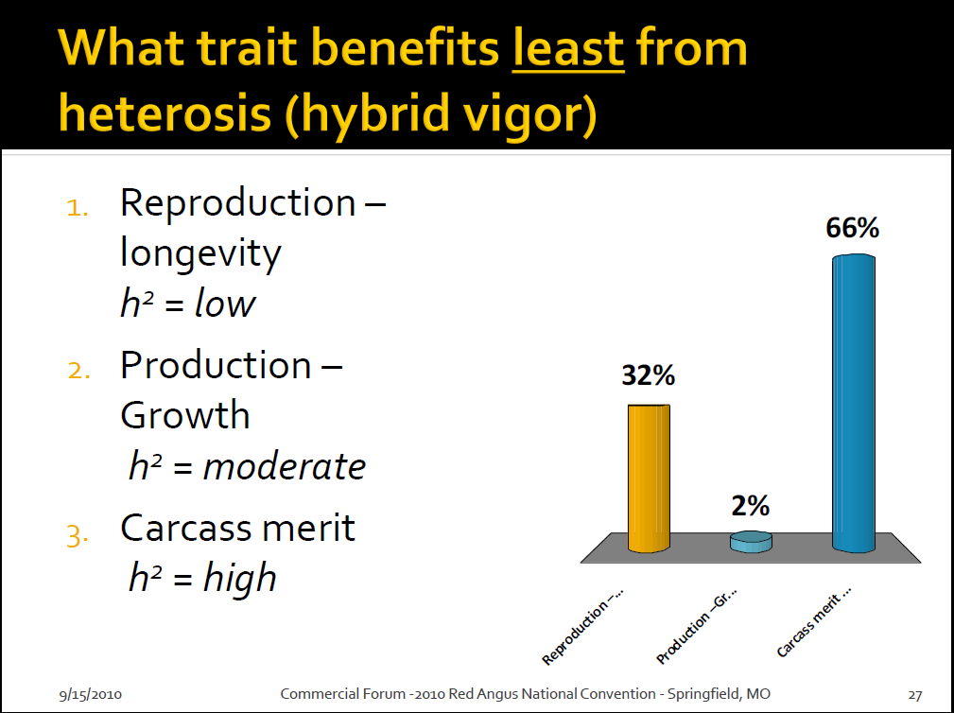

Slide 6
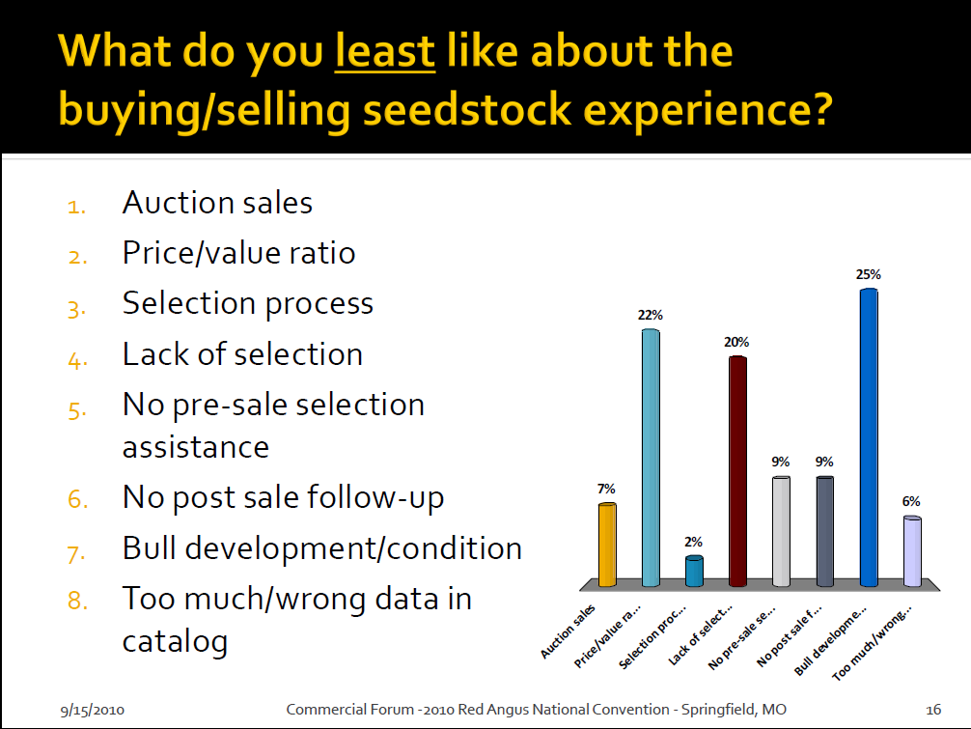

Slide 7

Why Crossbreed?
Profit
Headache

Slide 8
Impact on Profit
Profit = Revenue - Costs
Heterosis Impact

Slide 9
Matt–What Are the Benefits of Heterosis?

Slide 10
Heterosis
Hybrid Vigor
Superiority of a crossbred animal as compared to the average of its straightbred parents
More divergent parental lines = more heterosis
NOT available from within breed matings

Slide 11
Inversely related
Heritability Heterosis
Low High
Moderate Moderate
High Low
Trait
Reproduction
(fertility)
Production
(growth)
Product
(carcass)

Slide 12
Advantages of the crossbred calf
Adapted from Cundiff and Gregory, 1999

Slide 13
Advantages of the crossbred cow
Adapted from Cundiff and Gregory, 1999.

Slide 14
Benefits of Heterosis
Heterosis increases production 20 to 25% per cow in Bos taurus x Bos taurus crosses; 50% in Bos indicus x Bos taurus crosses in subtropical regions
More than half of this effect is dependent on use of crossbred cows
Jenkins, MARC
Notes:
This slide summarizes results from a longterm heterosis project completed in the 1970’s comparing production of straightbreds and crosses in all combinations among the Hereford, Angus, and Shorthorn breeds.
Weaning wt per cow exposed was increased 8.5 % by raising cross bred calves.
However the greatest advantages of crossbreeding depended on use of crossbred cows.
Weaning wt per cow exposed was increased 23 % in crossbred cows raising three way cross progeny. More than half of total heterosis effect was dependent on use of crossbred cow to take advantage of their improved reproduction rate and milk production.
In addition, longevity was increased, herd life was 1.9 yr longer for F1 cows than for straightbred cows. Break even cost so production were reduced 10%, these are savings that as essential today as ever, if the beef industry is to remain competitive with other meat products.

Slide 15
Bob–What Does this Mean in Terms of Economic Returns?

Slide 16
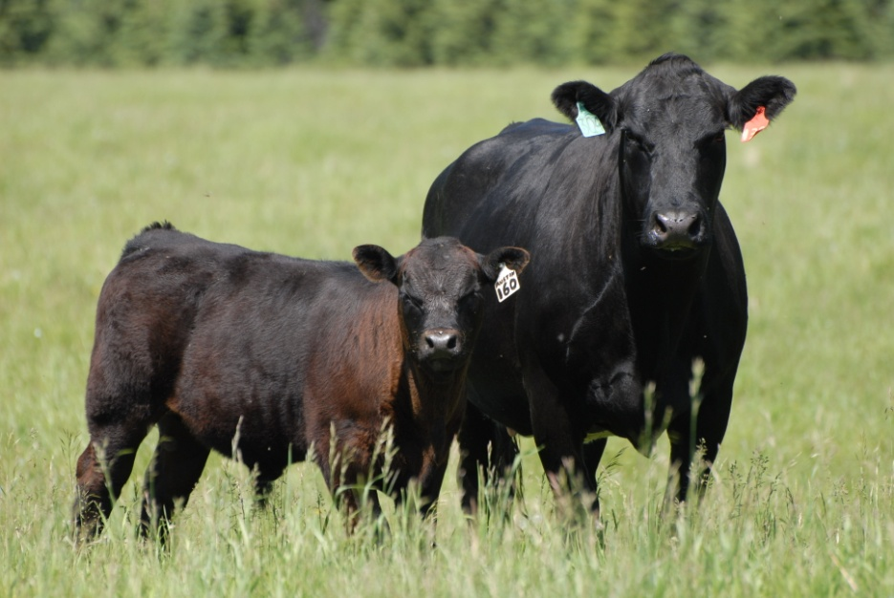
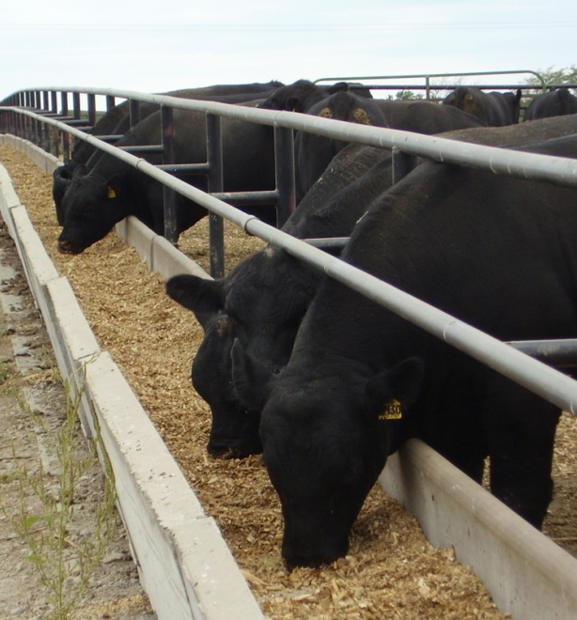
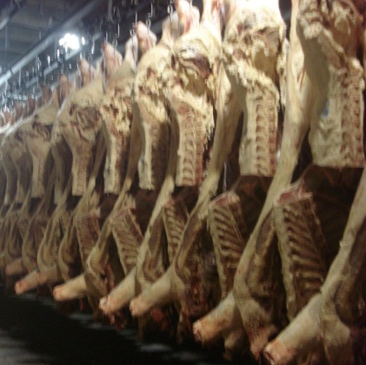
Relative Economic Weights for Integrated Beef Firm
Reproduction:Growth:End Product
2:1:1
(Melton, 1995)

Slide 17
Benefits of Heterosis
Heterosis increases production 20 to 25% per cow in Bos taurus x Bos taurus crosses; 50% in Bos indicus x Bos taurus crosses in subtropical regions
More than half of this effect is dependent on use of crossbred cows
Jenkins, MARC
Notes:
This slide summarizes results from a longterm heterosis project completed in the 1970’s comparing production of straightbreds and crosses in all combinations among the Hereford, Angus, and Shorthorn breeds.
Weaning wt per cow exposed was increased 8.5 % by raising cross bred calves.
However the greatest advantages of crossbreeding depended on use of crossbred cows.
Weaning wt per cow exposed was increased 23 % in crossbred cows raising three way cross progeny. More than half of total heterosis effect was dependent on use of crossbred cow to take advantage of their improved reproduction rate and milk production.
In addition, longevity was increased, herd life was 1.9 yr longer for F1 cows than for straightbred cows. Break even cost so production were reduced 10%, these are savings that as essential today as ever, if the beef industry is to remain competitive with other meat products.

Slide 18
Improvement of Herd Efficiency
[Dam Weight*Lean Value of Dam + No. Progeny*Progeny Weight*Lean Value of Progeny] - [Dam Feed*Value of Feed for Dam + No. Progeny*Progeny Feed*Value of Feed for Progeny].
By simply increasing number of progeny per dam through either selection, heterosis from crossing, or better management, we will increase efficiency of production.
        Adapted from Dickerson 1970

Slide 19
The Dollars of Heterosis
100 cows, 80% Weaning Rate, 575 avg. weaning weight, 10 year horizon
Calf Survival to Weaning (6%) = 60 hd.
Weaning wt. (4%) = +19,780 lb.
Weaning wt. per cow exposed (23%) = +105,800 lb.
  …or the equivalent of 18 more 575 lb. calves/year
  Heterosis is worth ~$250/cow/year
  ($2.50/lb for 5-6 cwt calves)
  Decreases breakeven by $0.43/lb…straightbred would have to generate an additional $330 per head to be equivalent

Slide 20
Crux of Straight-breeding
Do the benefits of selection for economically important/convenience traits within breed (straight-breeding) outweigh the improvement of lowly heritable traits via heterosis (especially maternal)?
Selection should be for BOTH additive and non-additive genetic merit.

Slide 21
Bob–Will I sacrifice Uniformity/
Marketability of Calves By Crossbreeding?

Slide 22
Genetic Variation in Alternative Mating Systems
Optimum
Assumes that the Two F₁’s Used are of Similar Genetic Merit

Slide 23
Variation
Adapted from Gregory et al., 1999

Slide 24
Basic Model
Phenotype
Unexplained Variation
Contemporary Group
and Other Effects
Genetic Merit

Slide 25
Basic Model
A = Breeding value (Additive gene effects)
D = Dominance effects (pairing of genes effects)
I = Epistatic (interactions among genes)

Slide 26
Having Your Cake and Eating it Too
Commercial cattlemen SHOULD care about BOTH additive and non-additive effects.
Seedstock producers SHOULD focus on additive genetic merit, and putting it in a package that helps clientele exploit non-additive effects.

Slide 27
So, Matt–Breeds Have Changed Overtime, Does Heterosis Still Exist?
What About Complementarity?

Slide 28
Genetic Trends for
Weaning Weight, lb
Adapted from Spring 2012 Genetic Trends from Breed Associations
and 2012 AB-EPD factors (Kuehn and Thallman, 2012)

Slide 29
Genetic Trends for
Yearling Weight, lb
Adapted from Spring 2012 Genetic Trends from Breed Associations
and 2012 AB-EPD factors (Keuhn et al., 2012)

Slide 30
Genetic Trends for Yearling Weight, lb
Diff = 38 lb
Diff = 0.4 lb
Diff = 61 lb
Adapted from Spring 2009 Genetic Trends from Breed Associations
and 2011 AB-EPD factors

Slide 31
BREED GROUP MEANS (DEVIATIONS FROM HA & AH) FOR MATURE WEIGHT (ADJUSTED TO CONDITION SCORE OF 5.5) OF F1 CROSS COWS IN CYCLES I AND II (BIRTH YEARS: 1970-74) COMPARED TO CYCLE VII (BIRTH YEARS 1999-2000), lb
(0)
(- 6)
(- 9)
(- 92)
(- 22)
(- 43)
LSD < 26
(0)
(64)
(75)
(33)
(117)

Slide 32
Breed Complementarity
Harvest the core strengths of breeds
Crossing breeds to combine direct and maternal heterosis and breed effects to optimize performance levels
Match cows to environment, calves to market….

Slide 33
What about end-product traits?
Highly heritable so little effect of heterosis
Some breeds compliment each other very well
“Combination of quality and yield grade”
Cundiff et al., 2004

Slide 34
Bob–How Do I Decide Which Breeding System Is Right For Me?

Slide 35
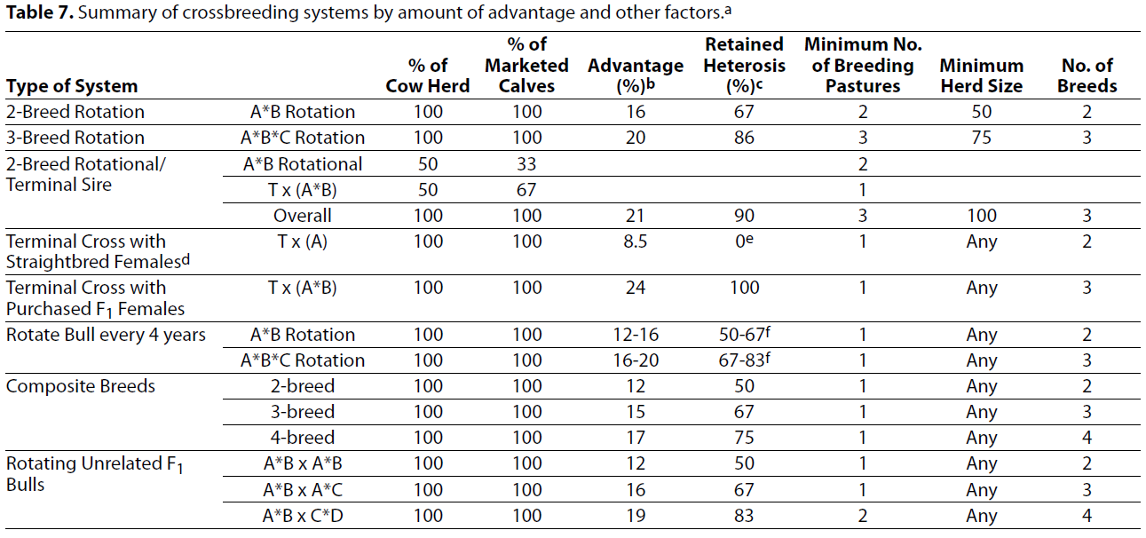
Systems, Benefits, Constraints

Slide 36
Choosing a breed
Adapted from Gosey

Slide 37
Retained heterosis
Mating of crossbred animals leaves you with 0 heterosis…WRONG
Heterosis is retained in future generations
Related to the probability of alleles from different breeds pairing together
  Note that expected and realized heterosis may differ due to the relationship of breeds
  Heterozygosity and heterosis are not linearly related

Slide 38
Retained Heterosis
n = number of breeds in crossbreeding system
p_{i} = percentage of each breed
(Ritchie et al., 1999)

Slide 39
Examples
1/2 Simmental 1/2 Angus bull mated to 1/2 Simmental 1/2 Angus cows
  1-[(1/2*1/2)+(1/2*1/2)]=.5 or 50%
1/2 Limousin 1/2 Angus bull mated to Angus cows
  1-[(1/2*0)+(1/2*1)]=.5 or 50%

Slide 40
How Do I Choose a Breeding Program
Are you profit or premium focused?
  Why not both?
Herd size
  Efficient bull utilization/manage variation in marketing groups
How do I generate replacement heifers?
How do I market calves?
Constraints
  Environment
  Management

Slide 41
Providing Good Breeding System Consultancy to YOUR Customers
Know your stuff…here’s some help!
  http://www.nbcec.org/producers/sire.html
  http://www.extension.org/pages/18946/archived-beef-cattle-webinars#Mating_Systems_to_Solve_Problems_and_Add_Value_to_Beef_Production_Systems:_Crossbreeding_and_the_Power_of_Heterosis
Put your customer first
  What’s in your customers best interest is in your best interest
Product offering that ‘solves’ problems for your customers.

Slide 42
Providing Good Breeding System Consultancy to YOUR Customers
Know how to use Across Breed Adjustment tables
  Calculator to help: http://www.asi.k-state.edu/species/beef/research-and-extension/K-State_Across_Breed_EPD_Calculator_Worksheet_2014-2015.xlsx

Slide 43
Points to Ponder
Mature weight
  Weaning and yearling weight moderately to highly correlated to mature weight
    Increased yield comes at a cost in the cow herd
    Important to use terminal bulls on moderate cows
  Common breeds have all increased mature weight
    Use selection tools to moderate maternal lines
Heterosis in crossbred cows should increase their culling age, reduce replacement costs, and increase chances for a profitable herd
The notion that beef breeds should be all-purpose is common, but counterproductive
  Breeds are too similar, need to define a purpose
Heterosis is important and underutilized, but it is not a “free lunch”
  Greater production comes at the expense of higher inputs

Slide 44
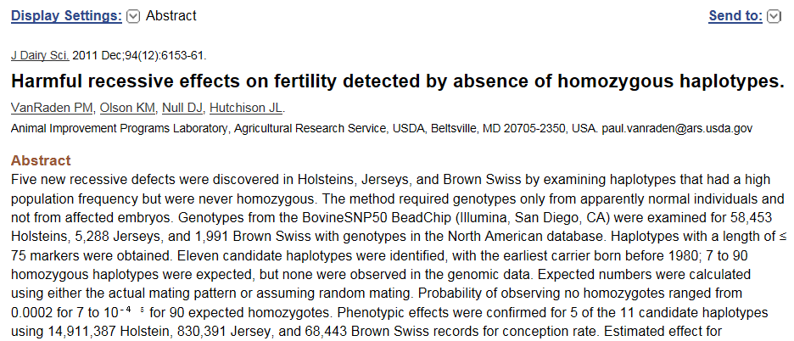
“missing” homozygotes

Slide 45
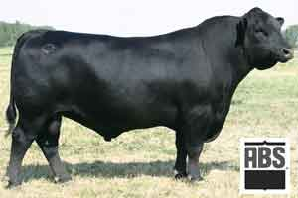
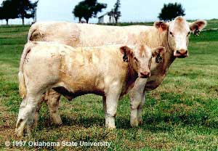
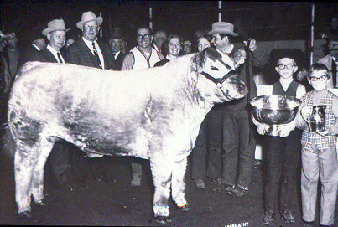
Predicting Crossbred Animals

Slide 46
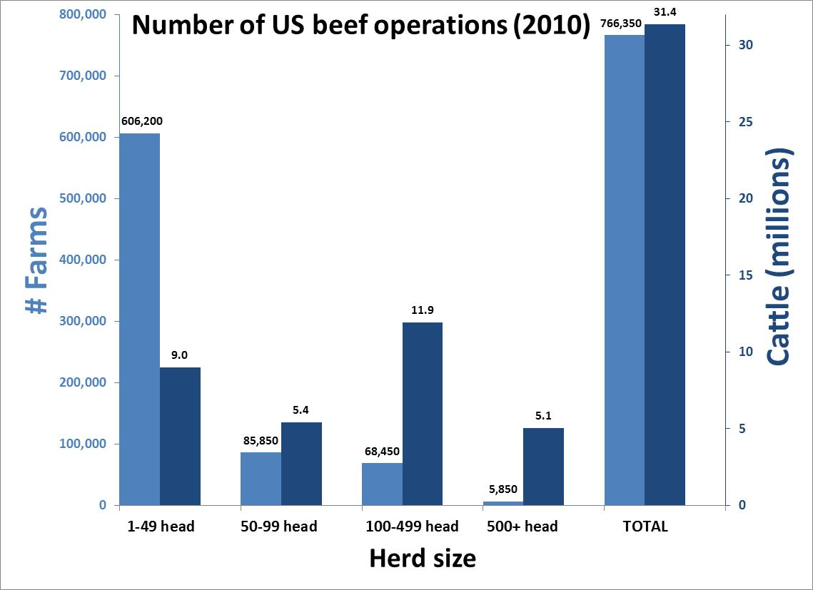

Slide 47
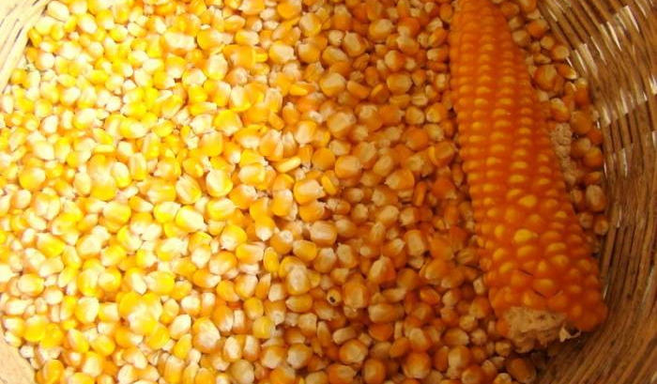
Future of Marketing Crossbred Bulls?

Slide 48
“The native cattle are extinct, but the island is full of artificial breeds. The agriculturalist Bakewell created sheep and cows and horses to order, and breeds in which everything is omitted but what is economical. The cow is sacrificed to her bag; the ox to his sirloin.”
Ralph Waldo Emerson

Slide 49
Is it worth the effort….
We think so…

Slide 50
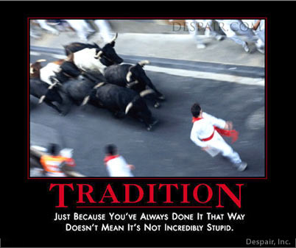

Slide 51
Questions to Ask Your Commercial Customer
What breed of cows do you have now?
What’s your marketing end point?
  How do you sell calves?
  Is that likely to change anytime soon?
How do you source replacement females
  Retained heterosis/maternal heterosis is paramount!
  Buy F1, produce your own
Environmental/managerial/grazing resources/breeding pastures, etc.

