Slide 1

We do the science.
You make the profit.

Slide 2
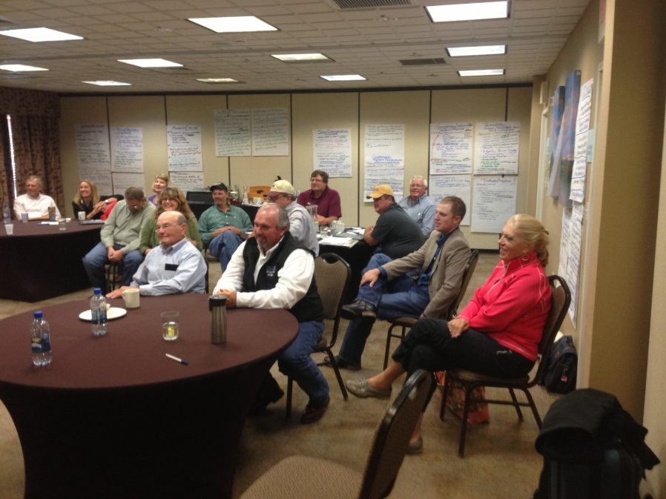
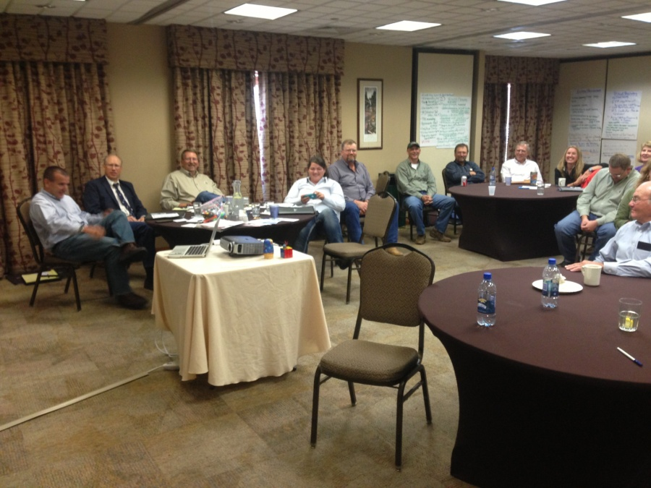
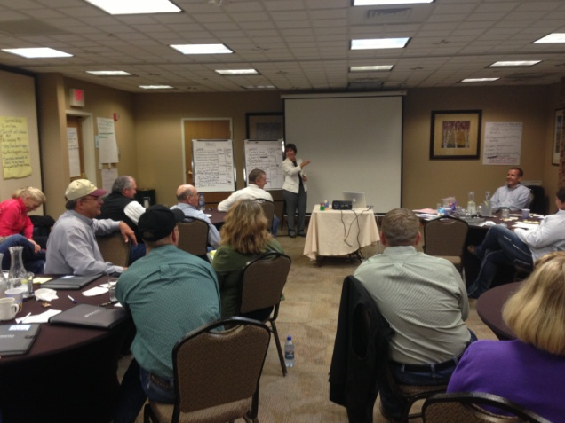
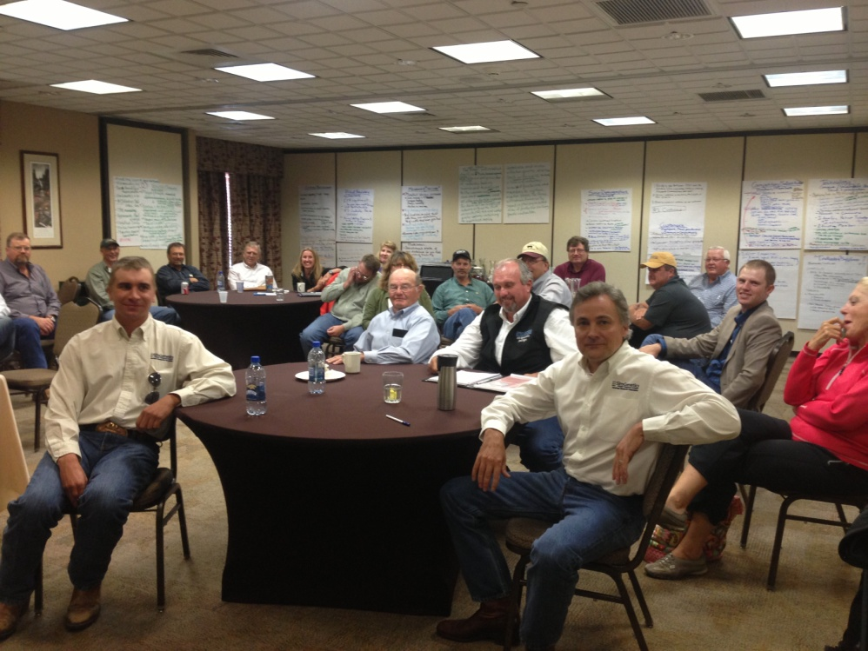
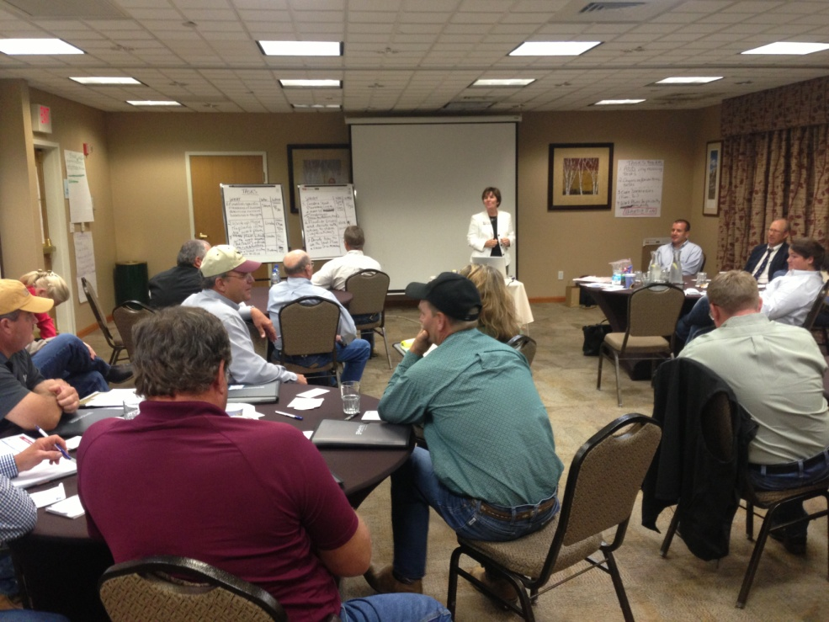
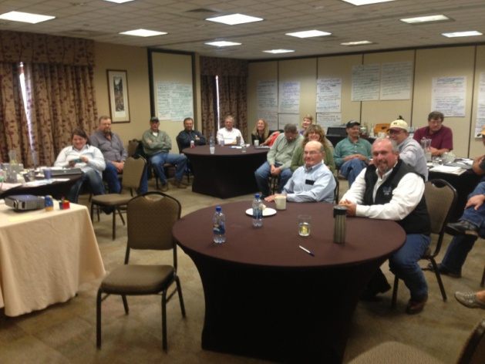
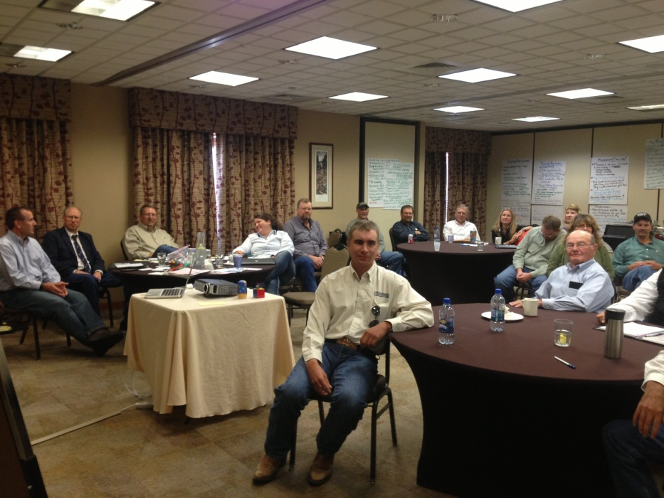

Developing Game Plan…
ASA Strategic Planning Session
September 9-10, 2013

Slide 3
Vision Statement…
The American Simmental Association believes the best way to serve its members, its members’ customers and the beef industry is through continual improvement and use of genetic and associated technologies. As such, the Association will continue to be a worldwide leader in the development and integration of these technologies for the beef industry. The Association will initiate and foster relationships with like-minded entities to enhance our ability to achieve this objective.
The Association will be widely recognized as having an unyielding commitment to scientific principles and as a hub for the industry's most progressive seed stock producers – an organization that is extremely cooperative with all facets of the industry and tirelessly devoted to the success of its members and its members' customers.

Slide 4

Mission Statement…
The success of the American Simmental Association is dependent on the success of our members. In turn, our members’ success is dependent on their cattle making an important and significant contribution to the beef industry. The highest priority is to use science and technology to develop and promote services and products, which bring value to ASA members’ customers.

Slide 5

In a Nutshell…
Exist to serve commercial industry
Leverage science to benefit industry
Collaborate to benefit industry
Is something missing?

Slide 6
ASA vs. Typical…
What’s the Difference?
ASA exists to serve our industry
Others exist to serve their breed

Slide 7
In a Nutshell…
Exist to serve commercial industry
Leverage science to benefit industry
Collaborate to benefit industry

Slide 8
In a Nutshell…
Exist to serve commercial industry
Leverage science to benefit industry
Collaborate to benefit industry

Slide 9
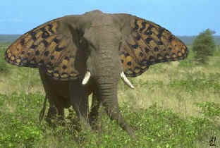
Leverage Science & Collaborate…
First Commandment of Commercial Beef Cattle Breeding:
Thou Shalt Crossbreed!!!

Slide 10
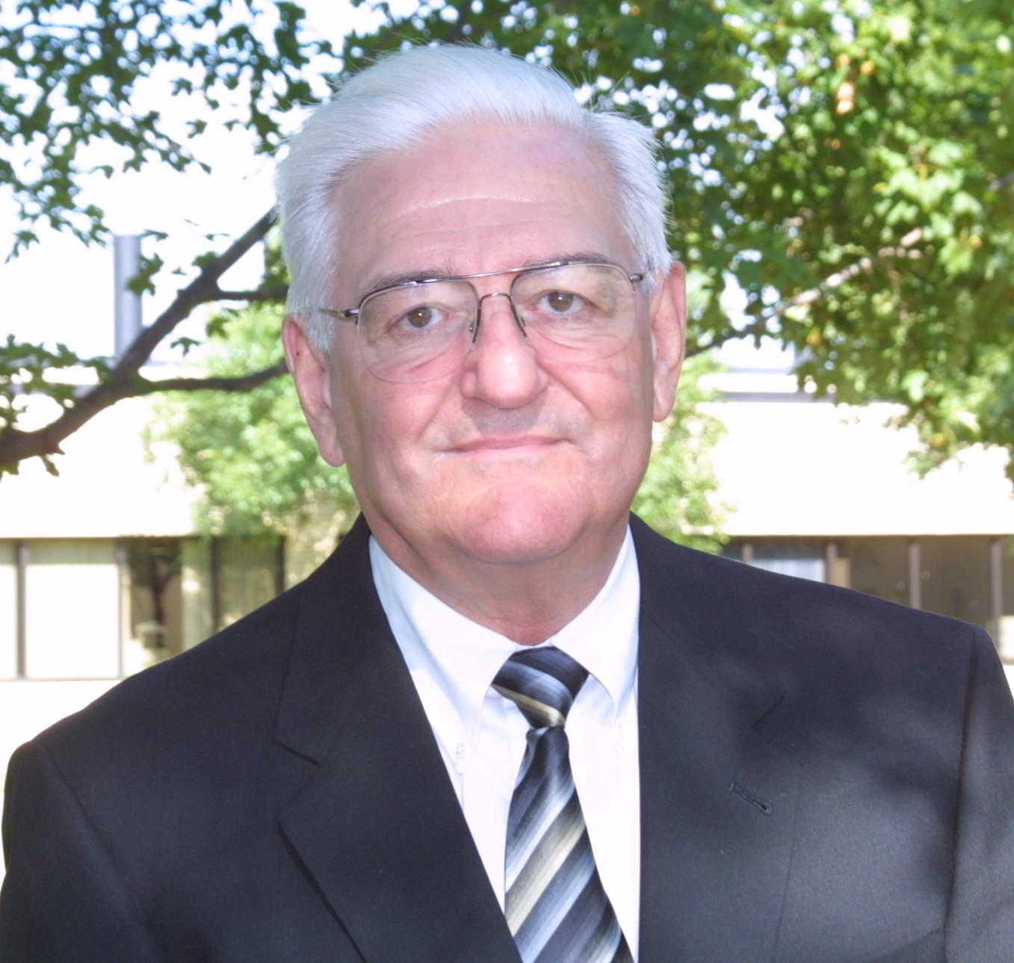
Leverage Science & Collaborate…
Thou Shalt Crossbreed!!!
"When it comes to beef cattle breeding, perhaps nothing can have a more positive and consistent impact on profit than a structured crossbreeding program".
Dr. Larry Cundiff

Slide 11

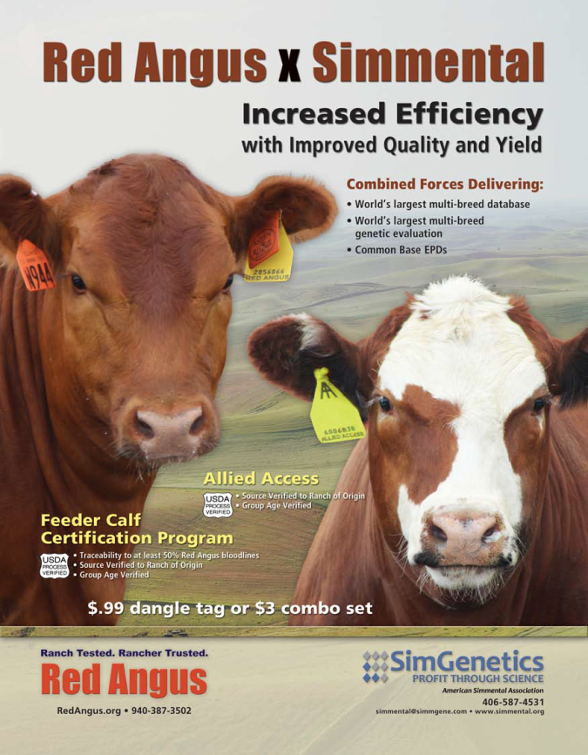

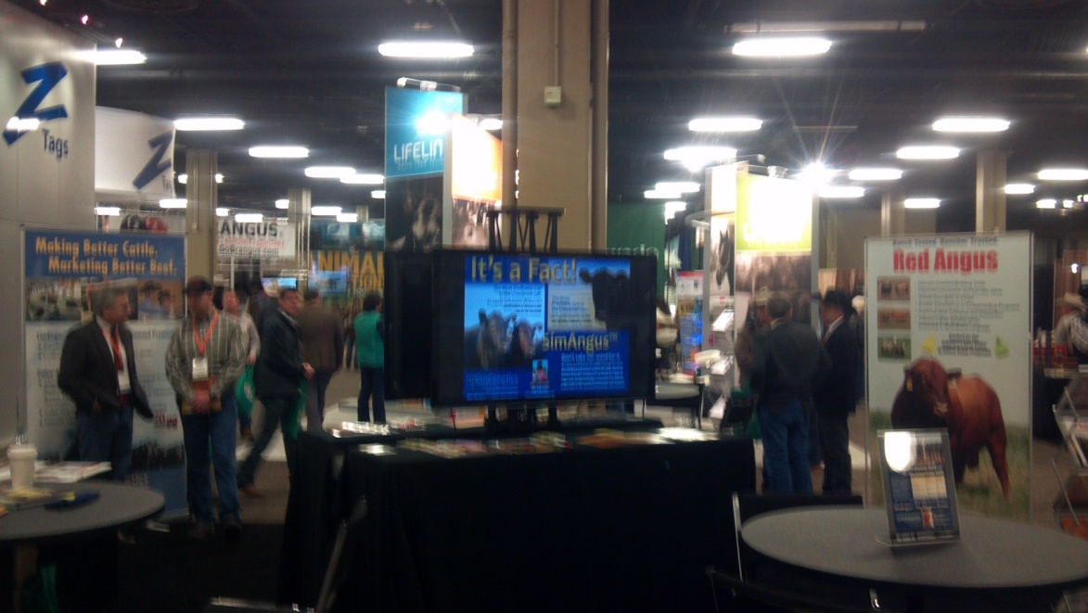
Leverage Science & Collaborate…

Slide 12














Leverage Science & Collaborate…
World’s Largest Multi-Breed Database & Genetic Evaluation…
and growing!

Slide 14

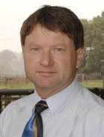
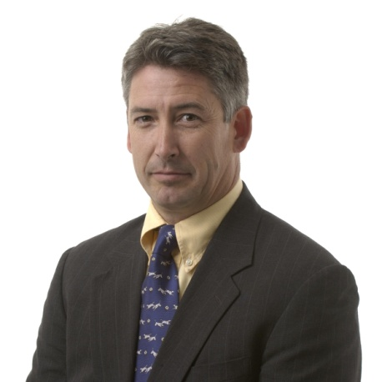
Leverage Science & Collaborate…
Operation Quantum Leap
Dorian Garrick
Bruce Golden
Building the next generation of National Cattle Evaluation software

